Slide 1
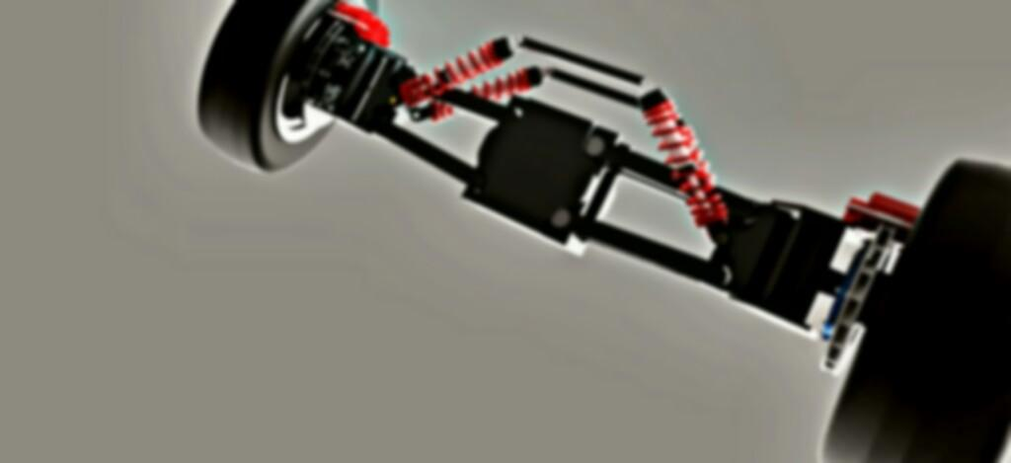

Smart India Hackathon 2020

Slide 2

Team name : Technothorn
Project name : Ultra-compact Personal Aerial Vehicle

Slide 3
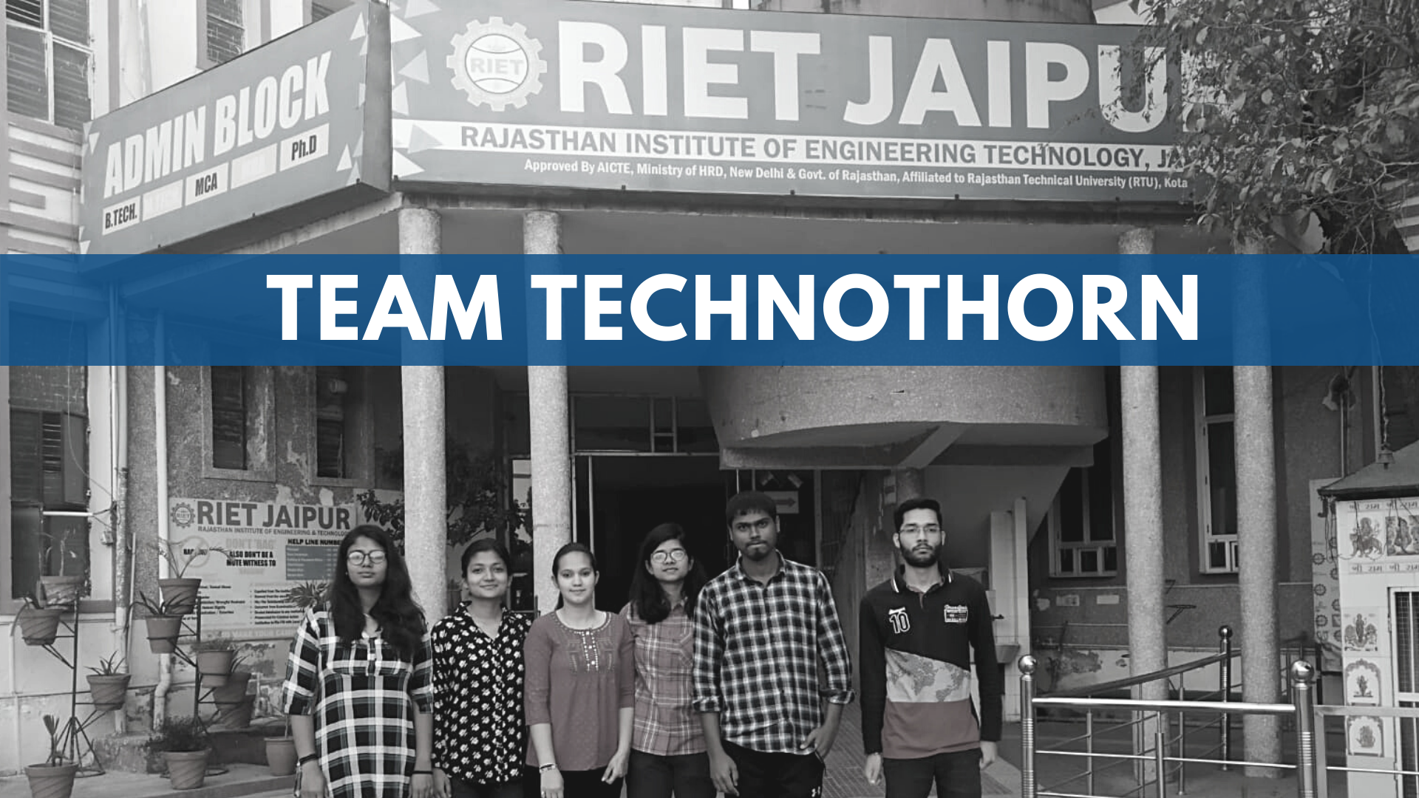

Slide 4
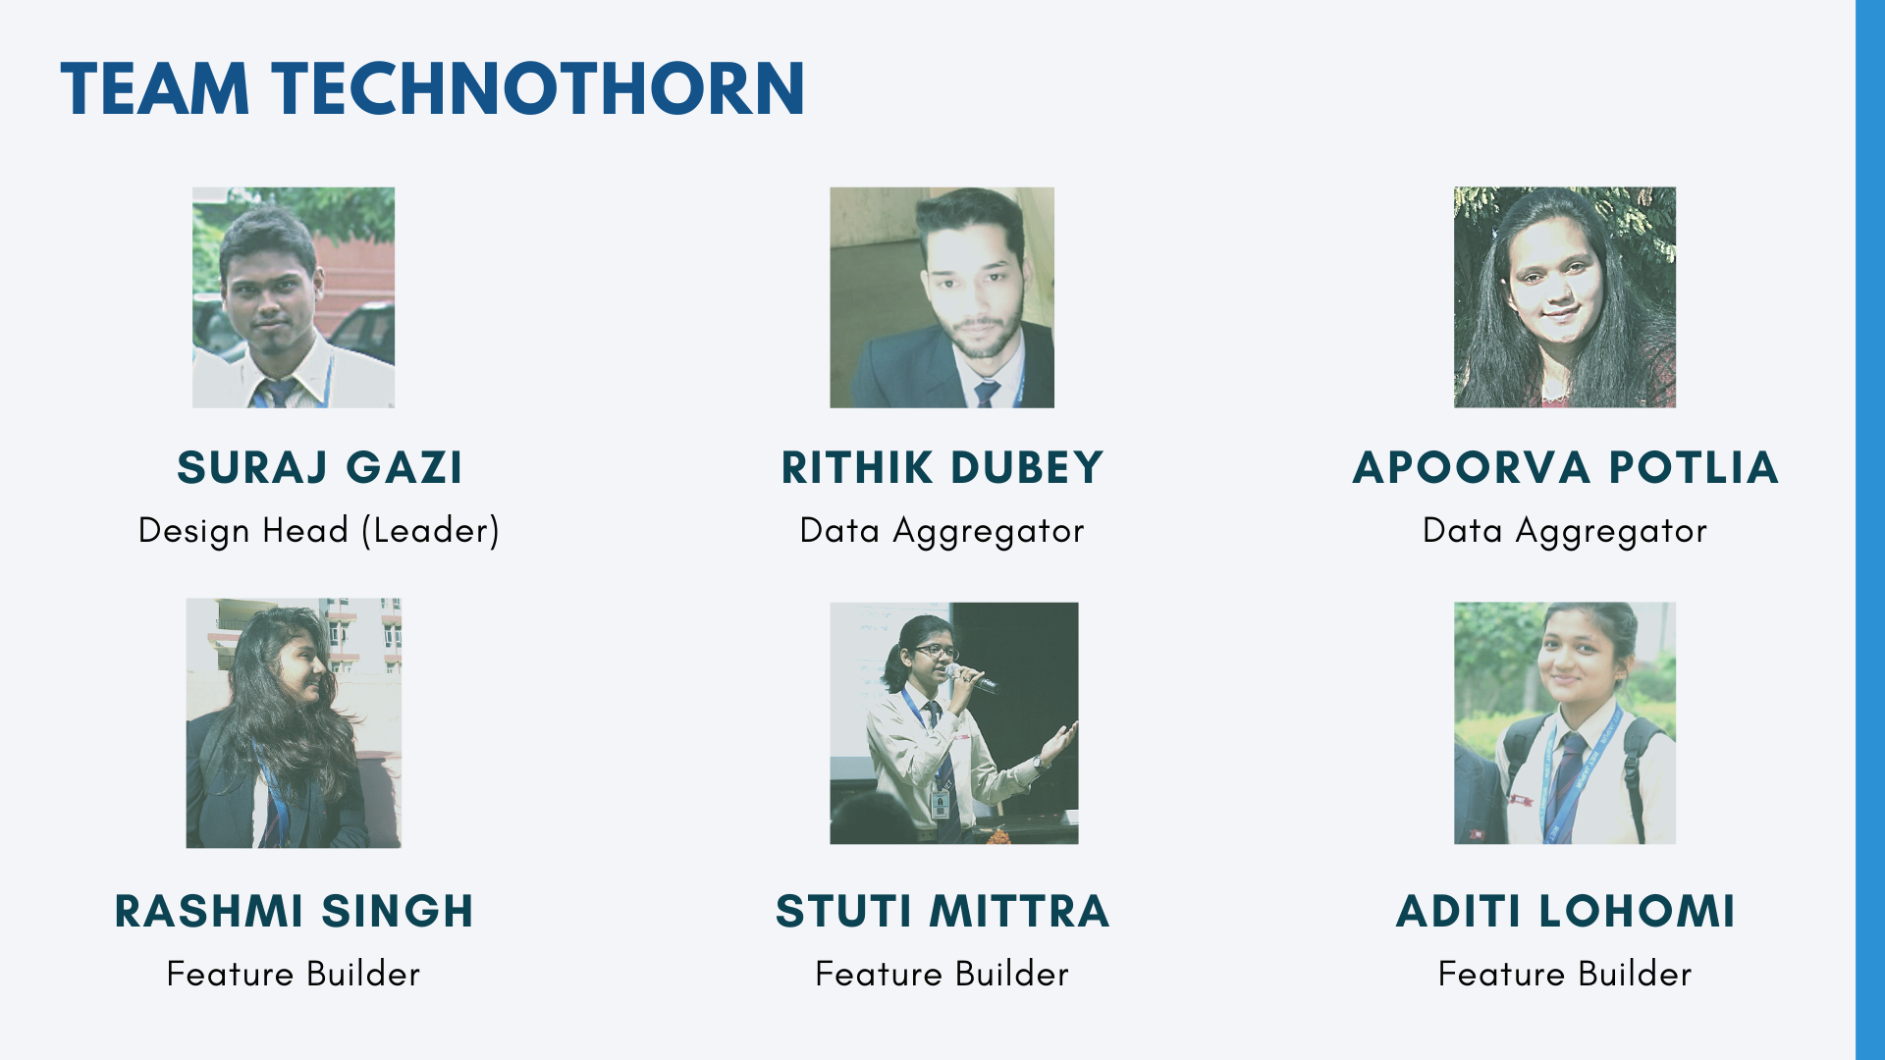
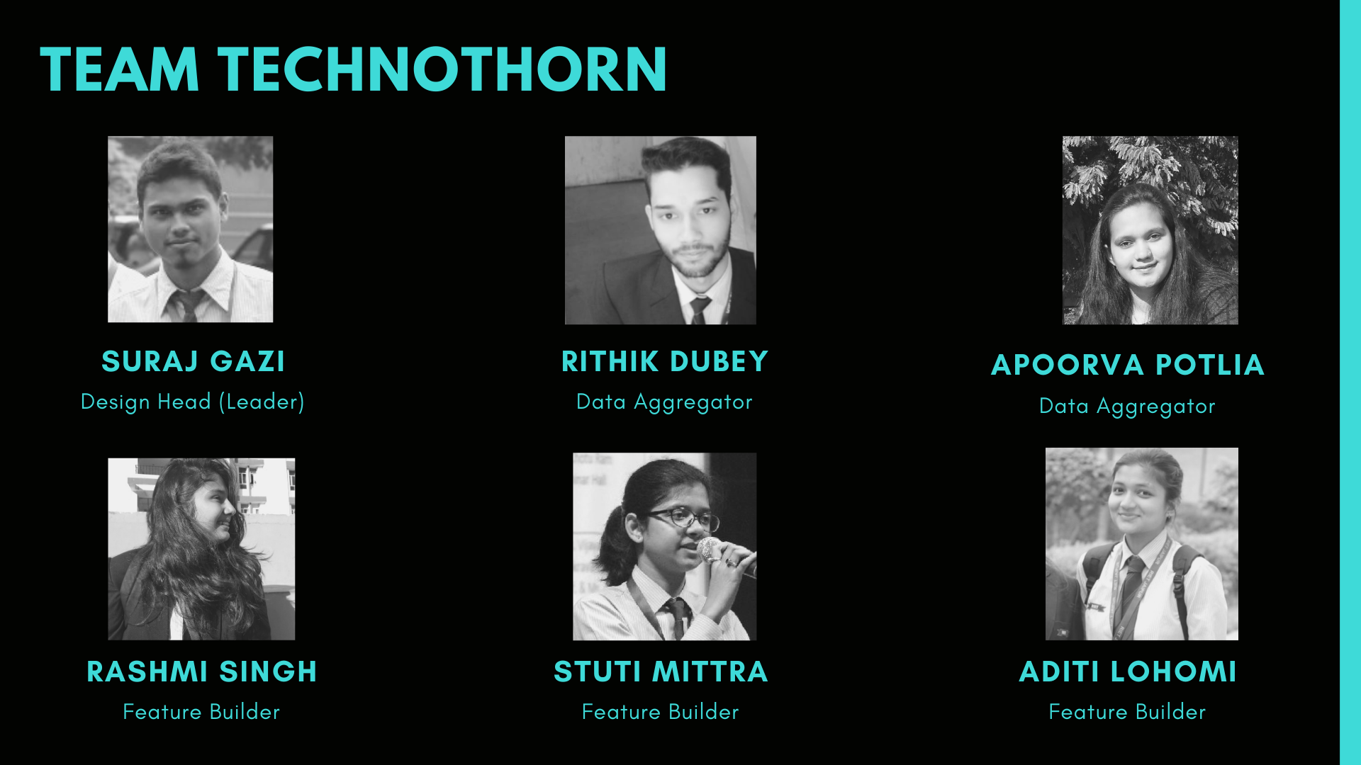

Slide 5
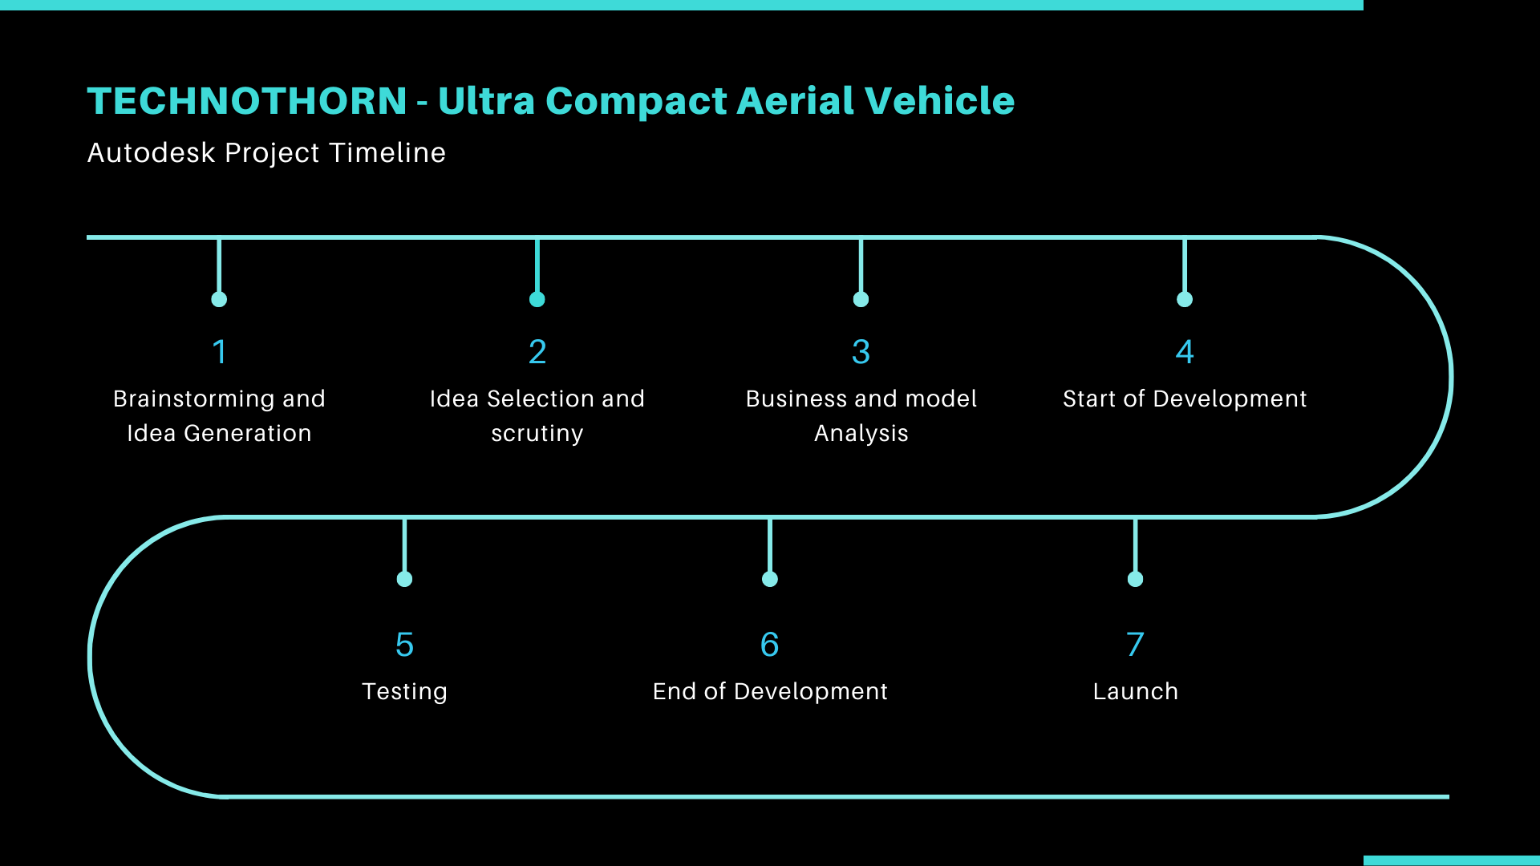
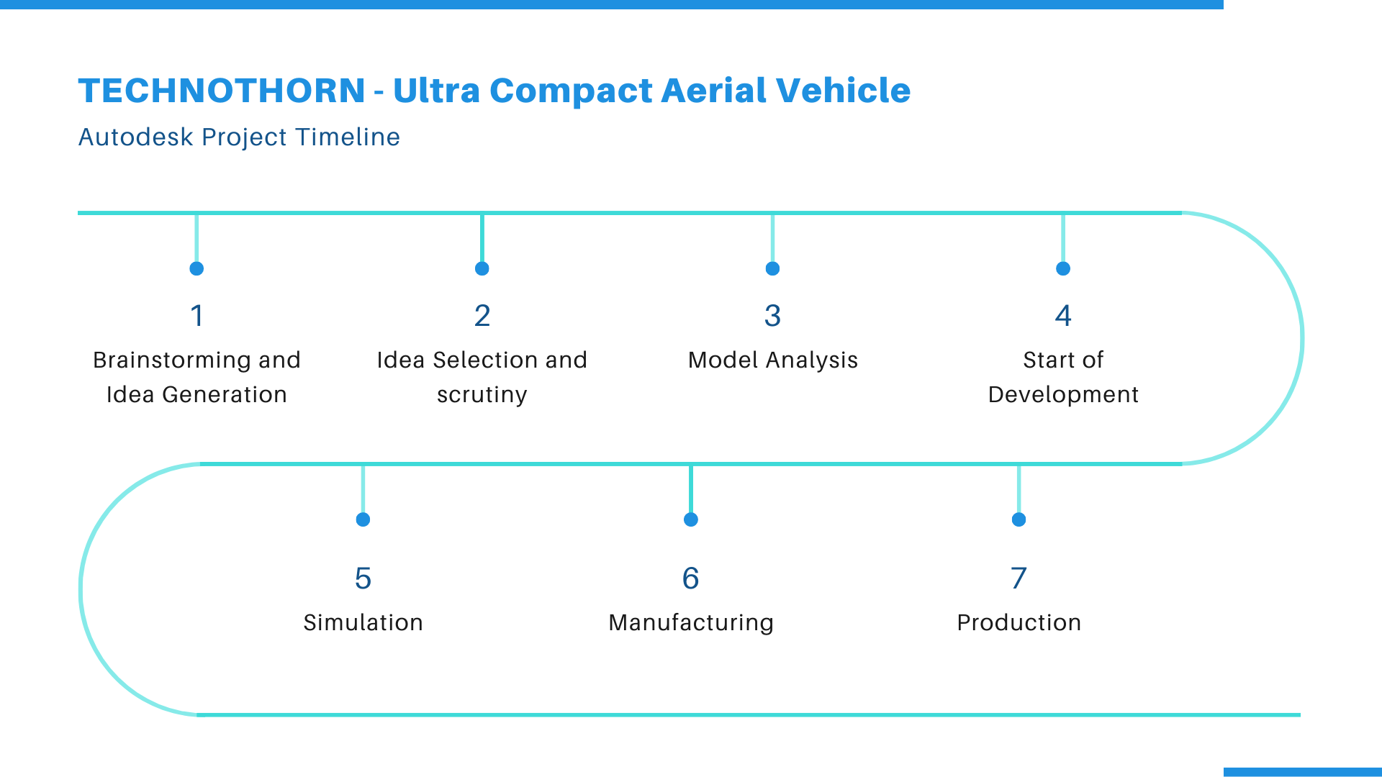

Slide 6


Slide 7
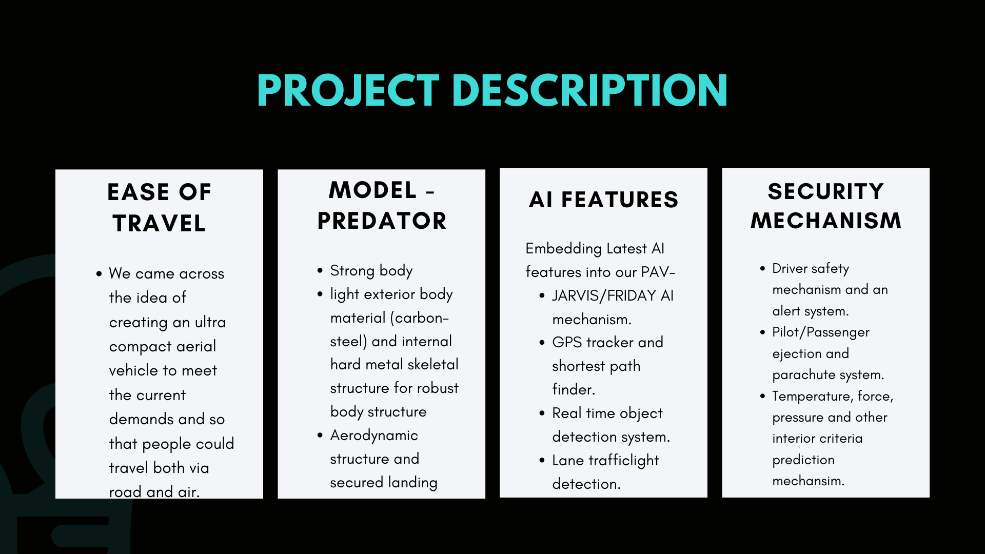
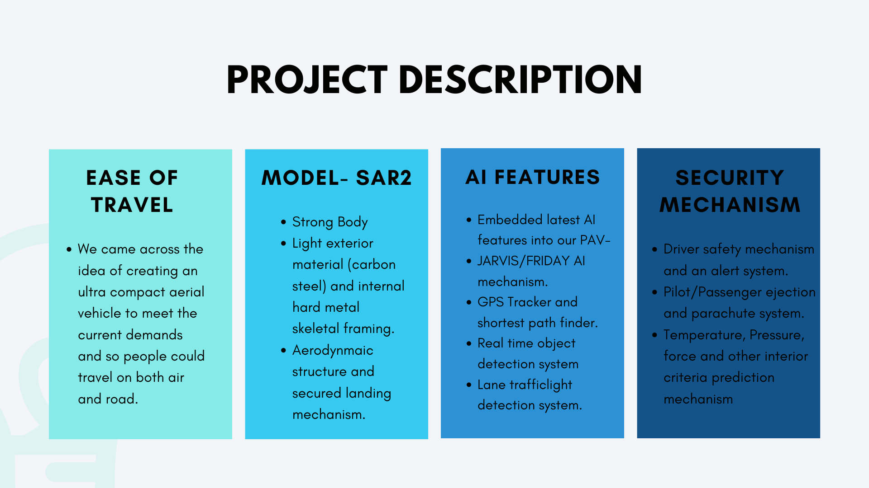


Slide 8
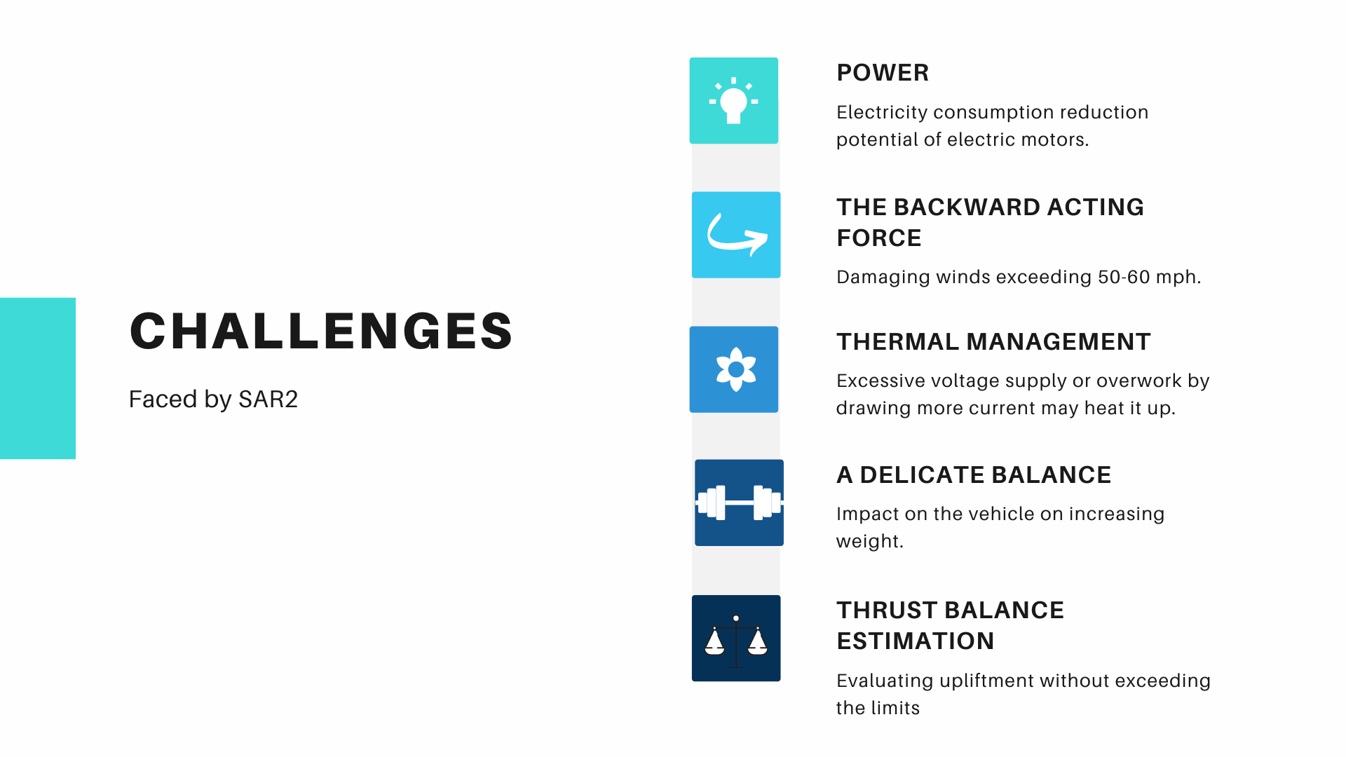

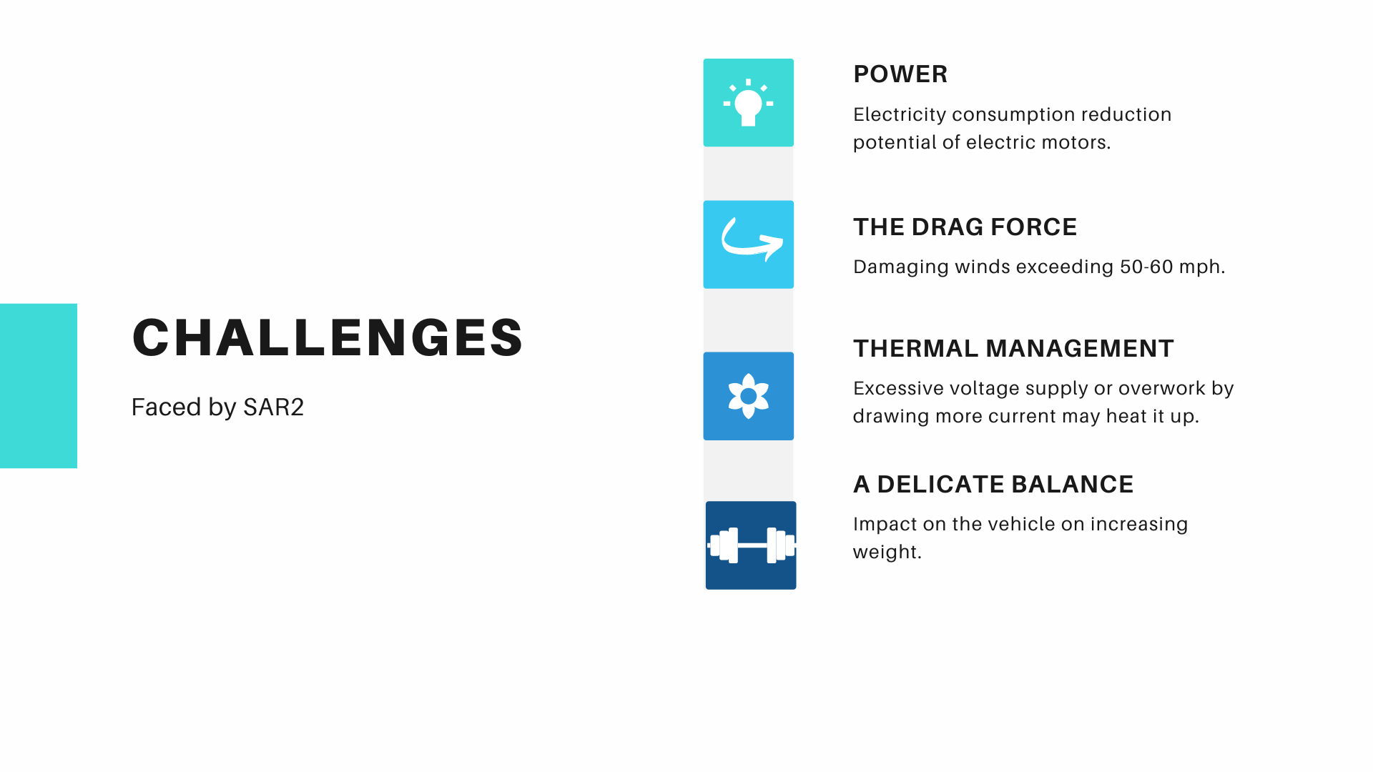
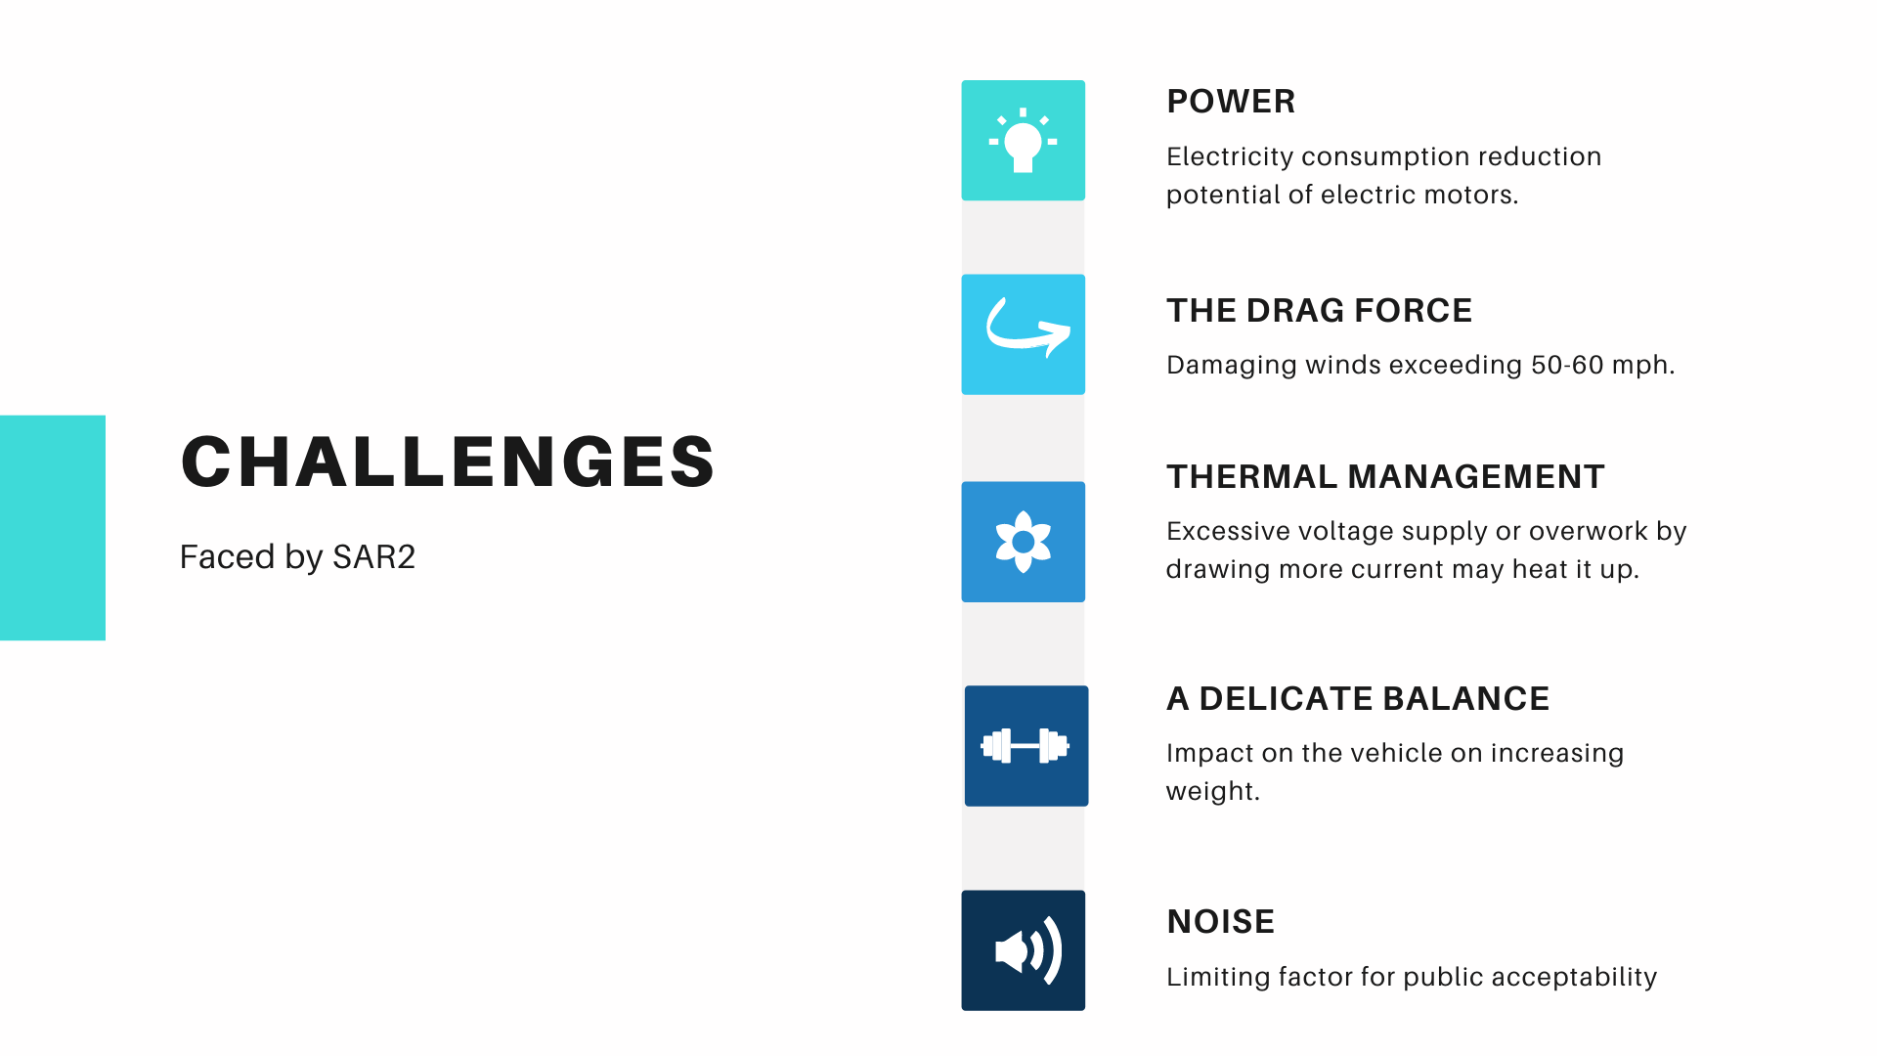

Slide 9
Key Features - SAR2
Speed - 90-100 km/hr (approx)
Height - 3.6 m
Width - 1.6 m
Weight - 800 kg
Total Power Supply - 725 HP [700(main requirement) + 25(reserve)]
Driver Safety Mechanism
2 Seater (Driver/Passenger)
Quad winged
Motor Speed - 3000 rpm
Comprehensive Management by the smart command and Control Centre
Radiator to regulate the heat generated inside the system
Electrically powered to reduce environmental harm caused by emission
Vertical take-off and landing
Team Technothorn

Slide 10
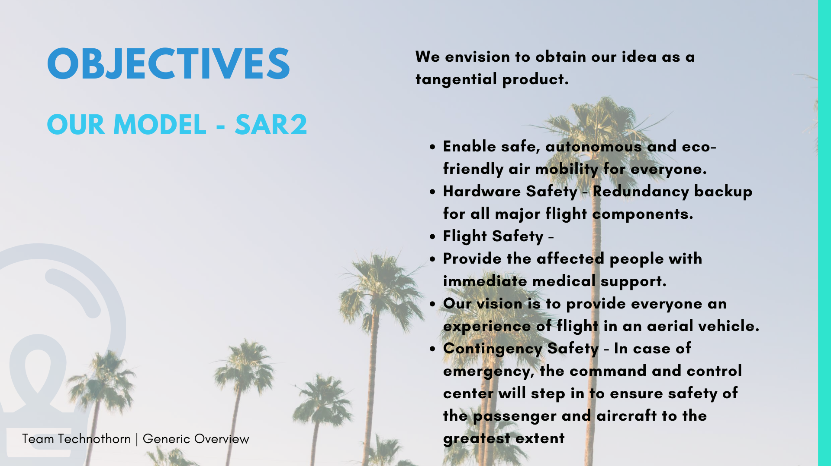
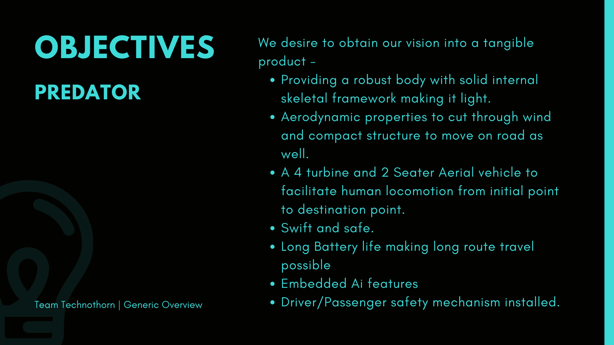
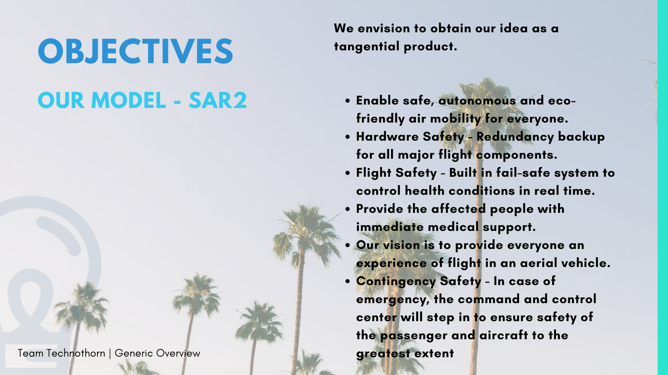


Slide 11
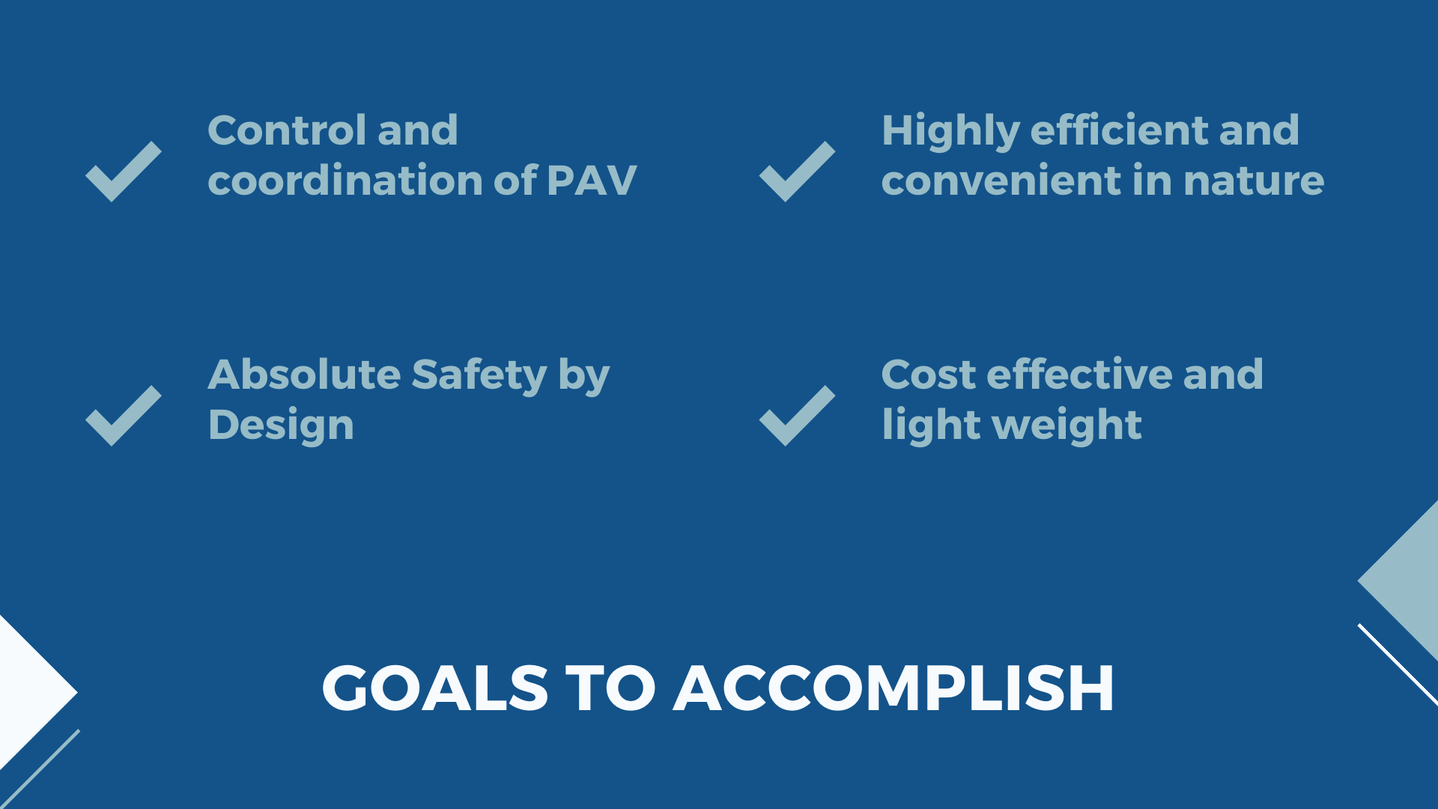

Slide 12
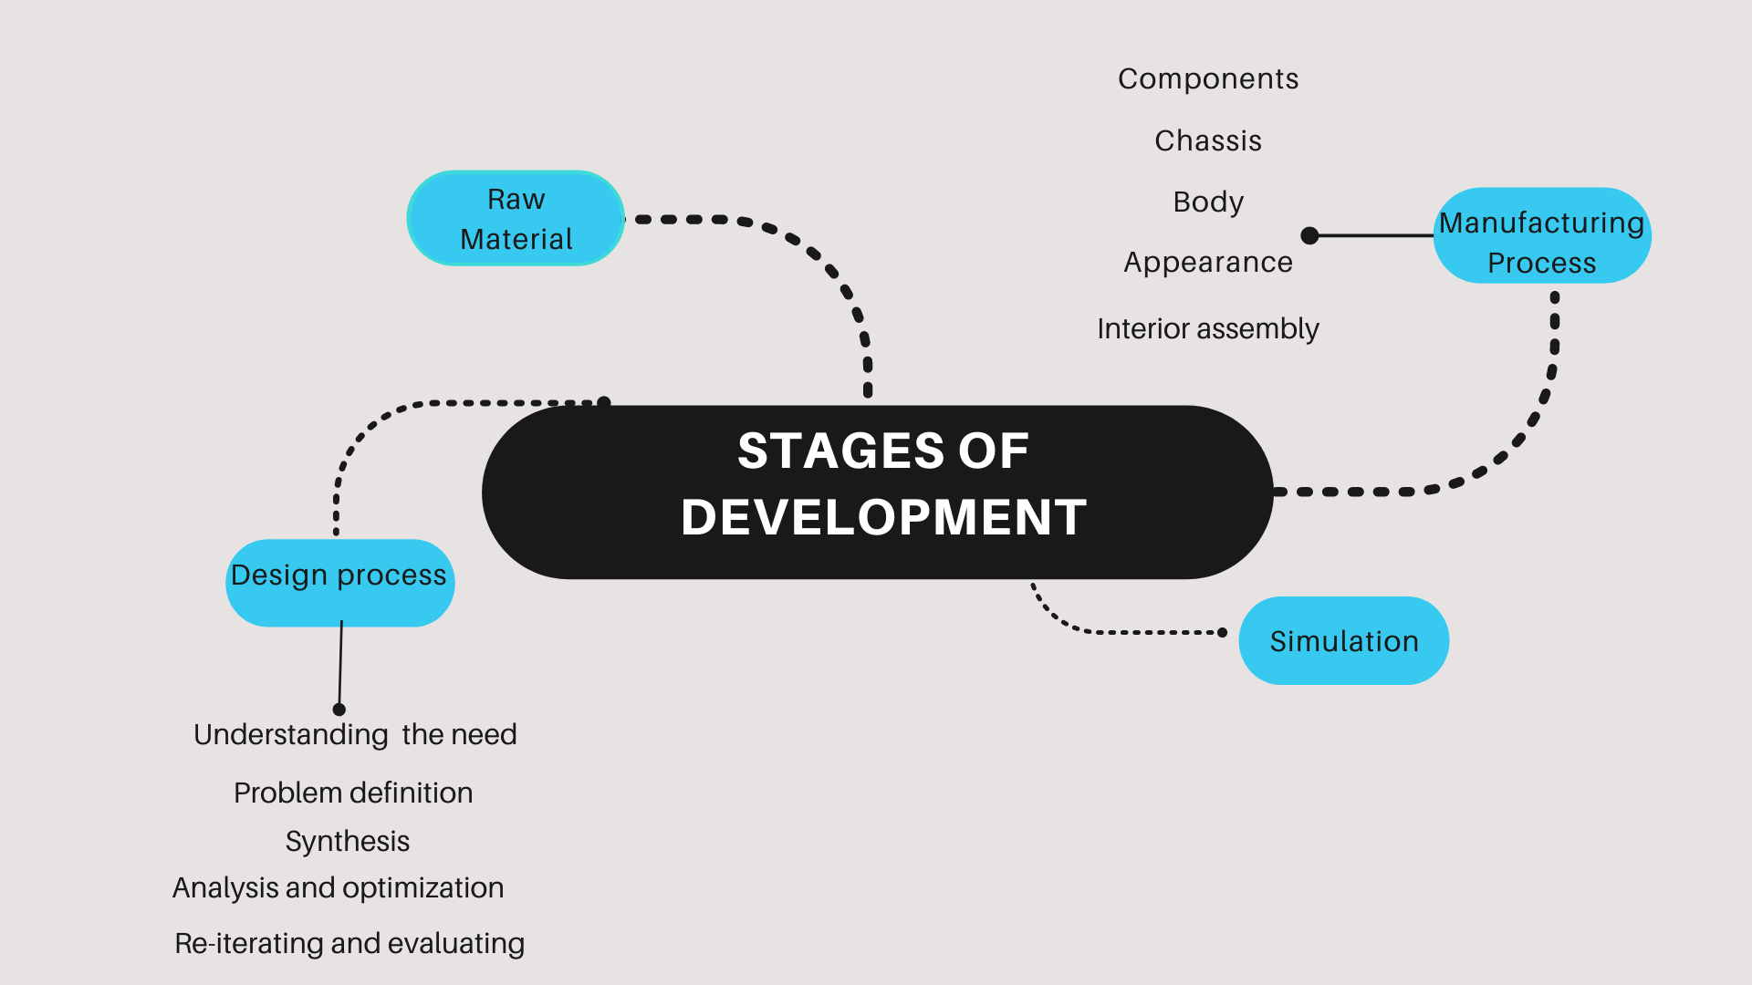

Slide 13
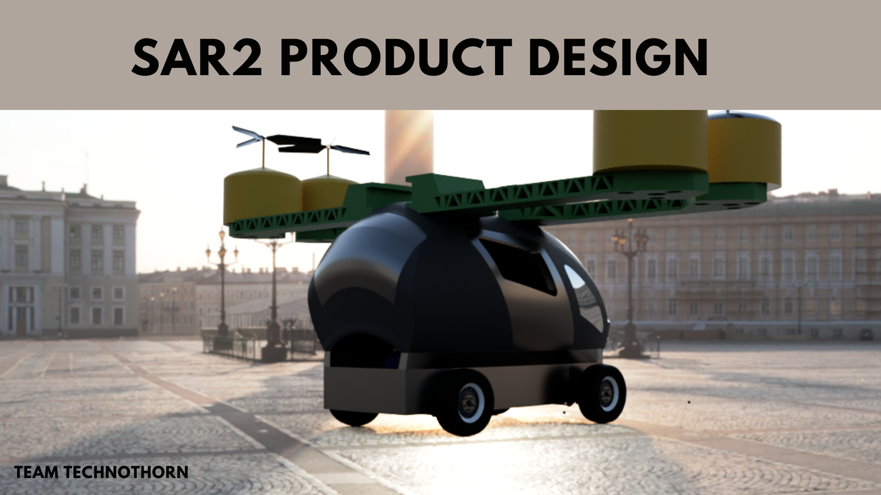
Final Product Image
# with every part description and specification
# a small rendered video if possible to be appended.
# add mission and vision
# add AI features slide.

Slide 14



OPEN FOR SUGGESTIONS

